Slide 1
Introduction to Operating Systems
Dr Sana Belguith

Slide 2
A brief history of Operating Systems

Slide 3
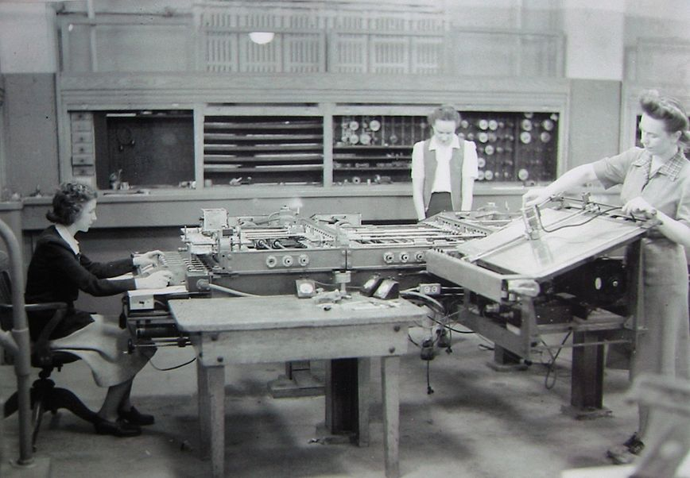
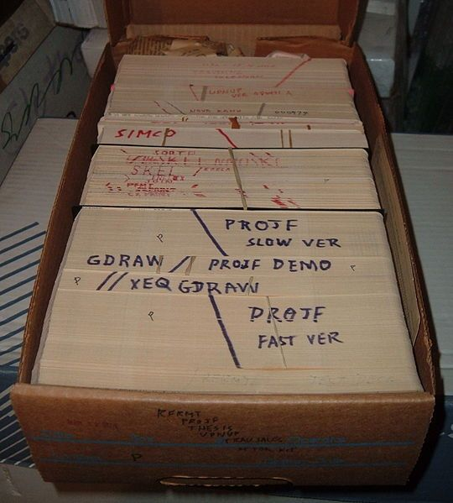
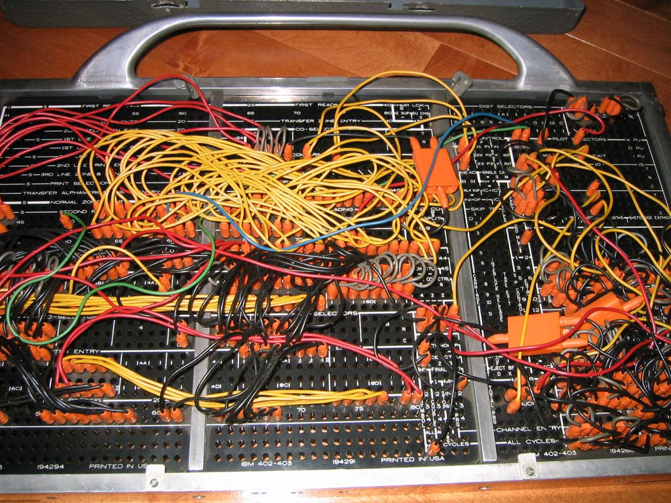
Phase 0: no operating systems (1940-1955)
Computer are exotic experimental equipment
Program in machine language
Use plugboard to direct computer
Program manually loaded via card decks
Goal: churn table of numbers (e.g. accounting)
Progress:
People develop libraries that they share with each others
These libraries are the precursor to today OSs

Slide 4
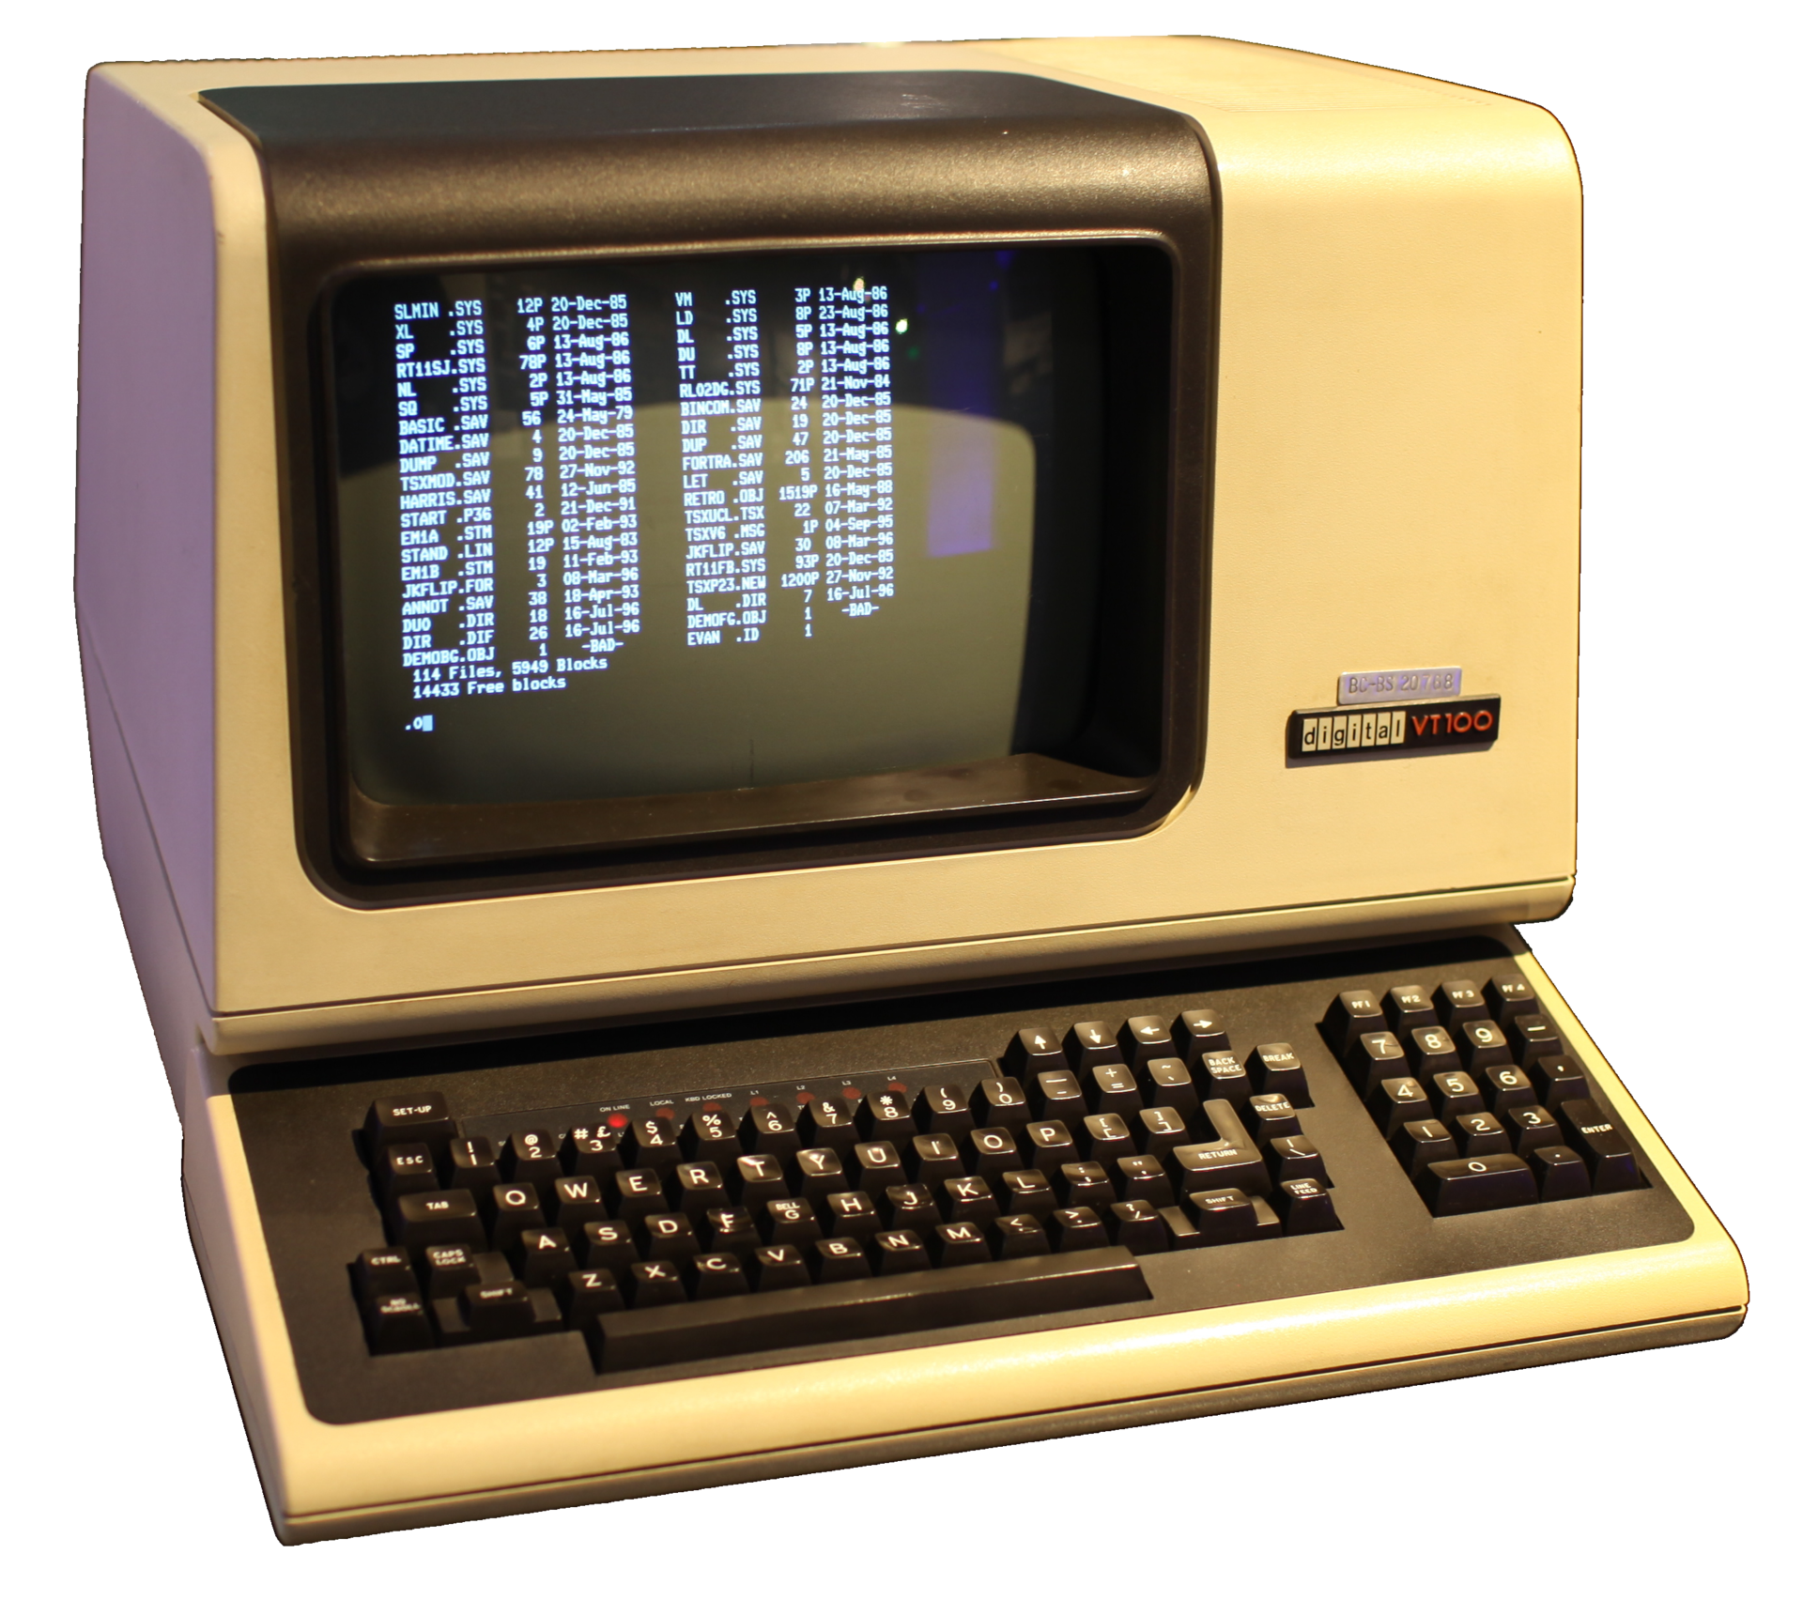
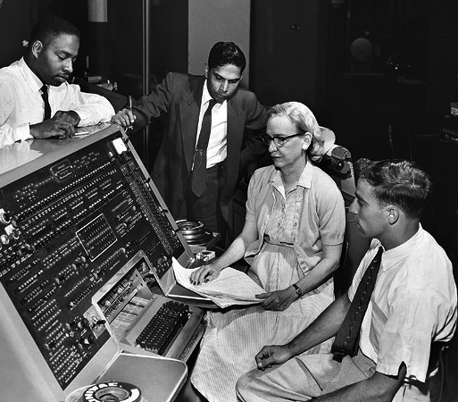
Phase 1: Expensive computers, cheap people (1955-1970)
Move the users away from the computer, give them terminal
OS is a batch monitors, a program that:
Load a user job
Run it
Move to the next
Program fails? Record memory, save it, move on
Efficient use of hardware (less “downtime”)
Hard to debug

Slide 5
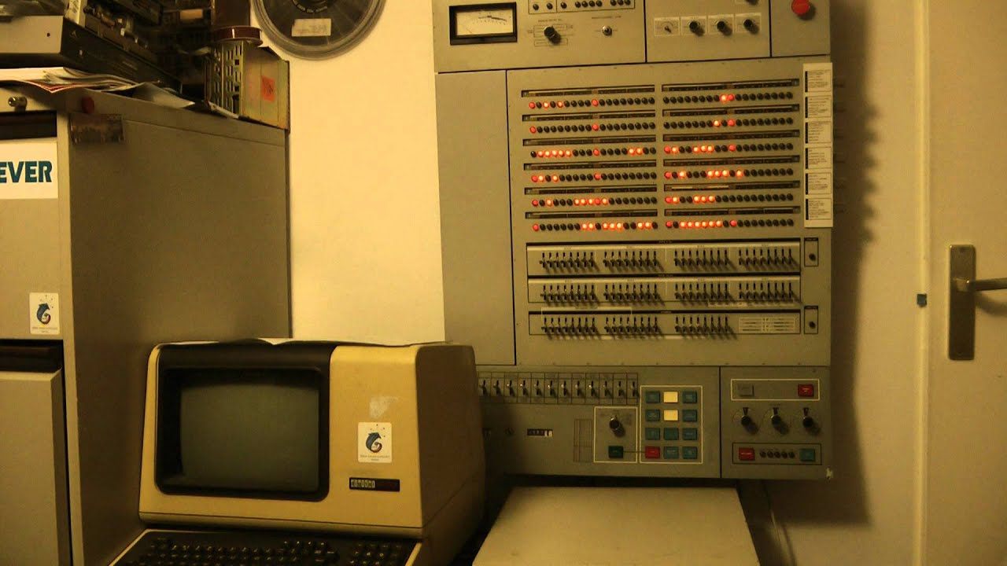
Phase 1: Technology
Problems:
Utilization is low (one job at a time)
No protection between different jobs
Short jobs get stuck behind long one
Solutions:
Hardware to the rescue: memory protection (separate code and data)
Multiprogramming: many users share the system
Scheduling: let short job finish quickly
OS must manage interactions between concurrent things
OS becomes an important area of research
OS/360: first OS to run on a family of machine (big and small)

Slide 6
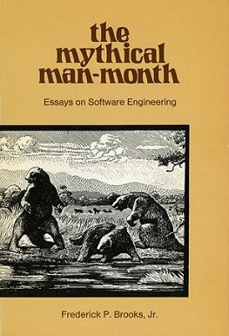
Phase 1: First OS
Operating Systems did not really work
OS/360 introduced in 1963… worked in 1968
Systems were enormously complicated
Written in assembly code
No structured programming
(extra read) The Mythical Man-Month

Slide 7
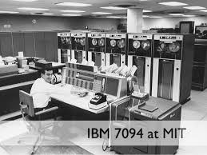
Phase 2: expensive computers, expensive people (1970-1980)
Help people to be more productive
Interactive timesharing: many people use the same machine at once
Terminals are cheap: everyone get one!
Emergence of the file systems
Try to give reasonable response time
CTSS
Developed at MIT
One of the first-time sharing system
Pioneered much of the work on scheduling
Motivation for MULTICS
MULTICS
Joint development by MIT, Bell Labs, General Electric
One computer for everyone, people will buy computing as they buy electricity
Many seminal ideas: hierarchical file systems, devices as files

Slide 8
Phase 2: UNIX
Ken Thompson (former MULTICS’ guy) wanted to use an old computer available at Bell Lab
He and Dennis Ritchie built a system built by programmers for programmers
Originally in assembly. Rewritten in C by Ritchie and Thompson
New idea: portable OS (i.e. not tied to a specific hardware)
Universities got the code for experimentation
Berkeley added virtual memory support
DARPA selected UNIX as its networking platform (ARPANET)
UNIX becomes a commercial OS
Important ideas popularized by UNIX
OS written in a high-level language (C)
OS is portable across hardware platforms
Mountable file systems
Many, many more

Slide 9
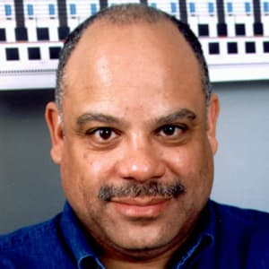
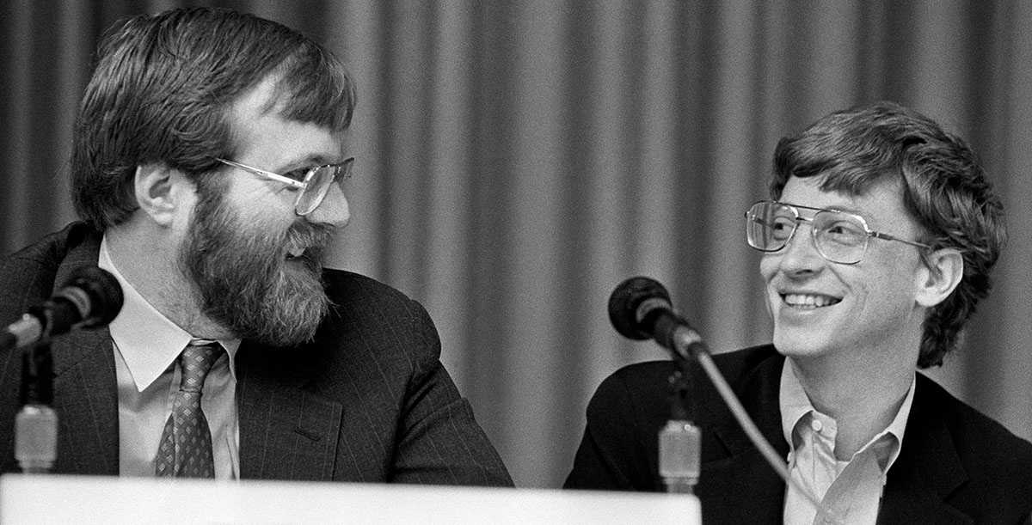
Phase 3: cheap computer, expensive people (1980-1990)
Put a computer in each terminal!
CP/M first personal computer operating system.
IBM needed an OS for its PC, CP/M behind schedule
Approached Bill Gates (Microsoft) to build one
Gates approached Seattle Computer Products, bought 86-DOS, and created MS-DOS
Goal: run Control Program/Monito (CP/M) programs and be ready quickly
Market is broken horizontally
Hardware
OSes
Applications

Slide 10
Phase 4: Networked Systems (1990s-today)
Connectivity is paramount!
People want to share
Networked applications propel industry
Email
Web
Protection and multiprogramming less important for individual machines
Protection and multiprogramming more important for servers
New network-based architectures
Clusters
Grids
Distributed Operating Systems
Cloud
Linux everywhere! (except in workstations)

Slide 11
Phase 5: the beginning of something new?
Are we on the verge of something new?
IoT, smartphones etc.

Slide 12
What is an operating system?
A computer program that
Multiplexes hardware resources
Implements resource abstractions
It is just another program… but a large and complex one
most complex piece of code you would have seen so far
Multiplexing: allows multiple people or programs to use the same set of hardware resources—​processors, memory, disks, network connection—​safely and efficiently.
Abstractions: processes, threads, address spaces, files, and sockets—​simplify the usage of hardware resources by organizing information or implementing new capabilities.

Slide 13
Why study OS?
Reality: this is how computers really work, and as a computer scientist or engineer you should know how computers really work.
Ubiquity: operating systems are everywhere, and you are likely to eventually encounter them or their limitations.
Beauty: operating systems are examples of mature solutions to difficult design and engineering problems. Studying them will improve your ability to design and implement abstractions.

Slide 14
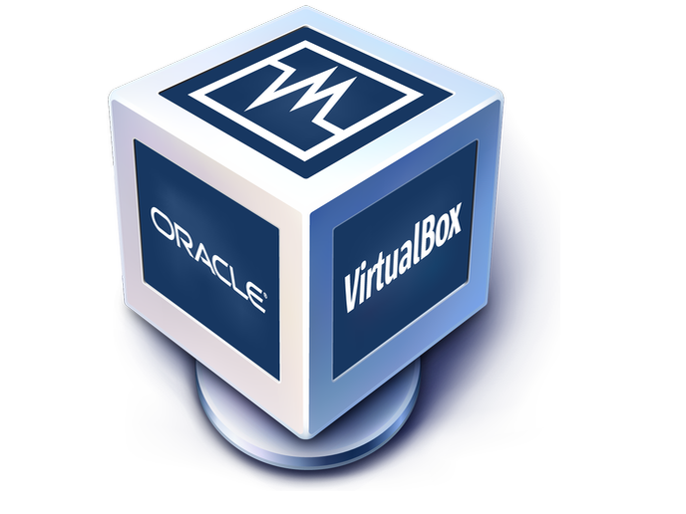


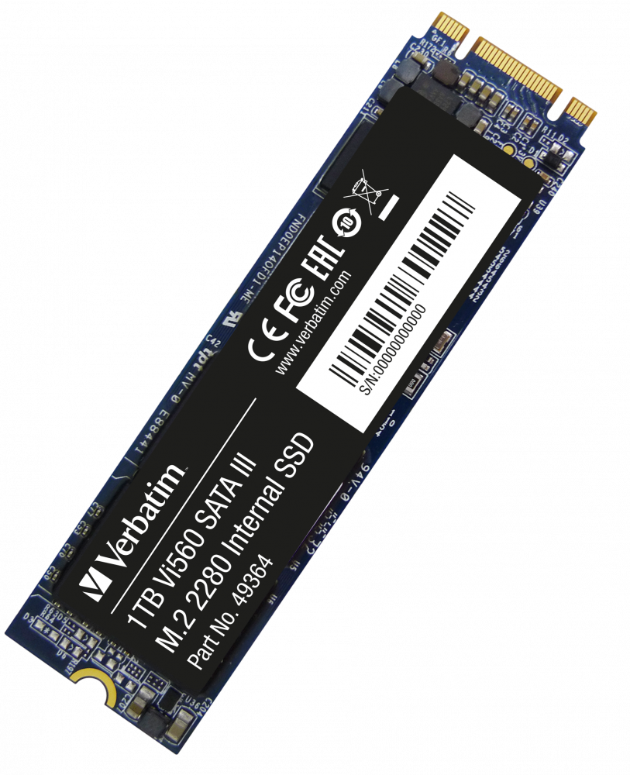
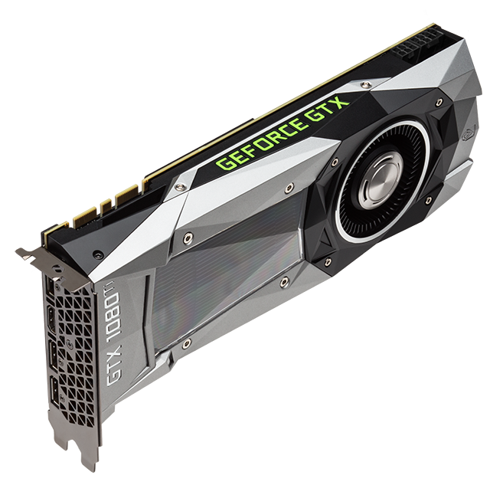
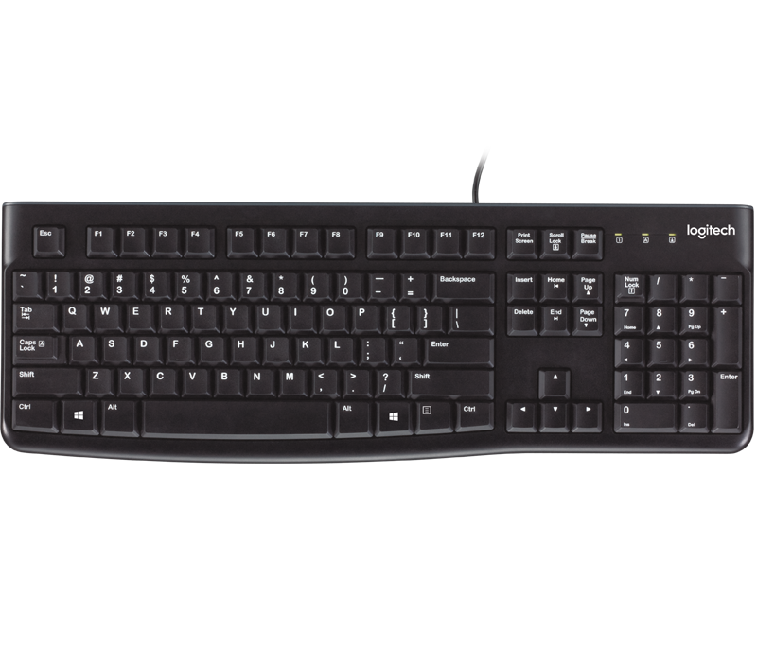
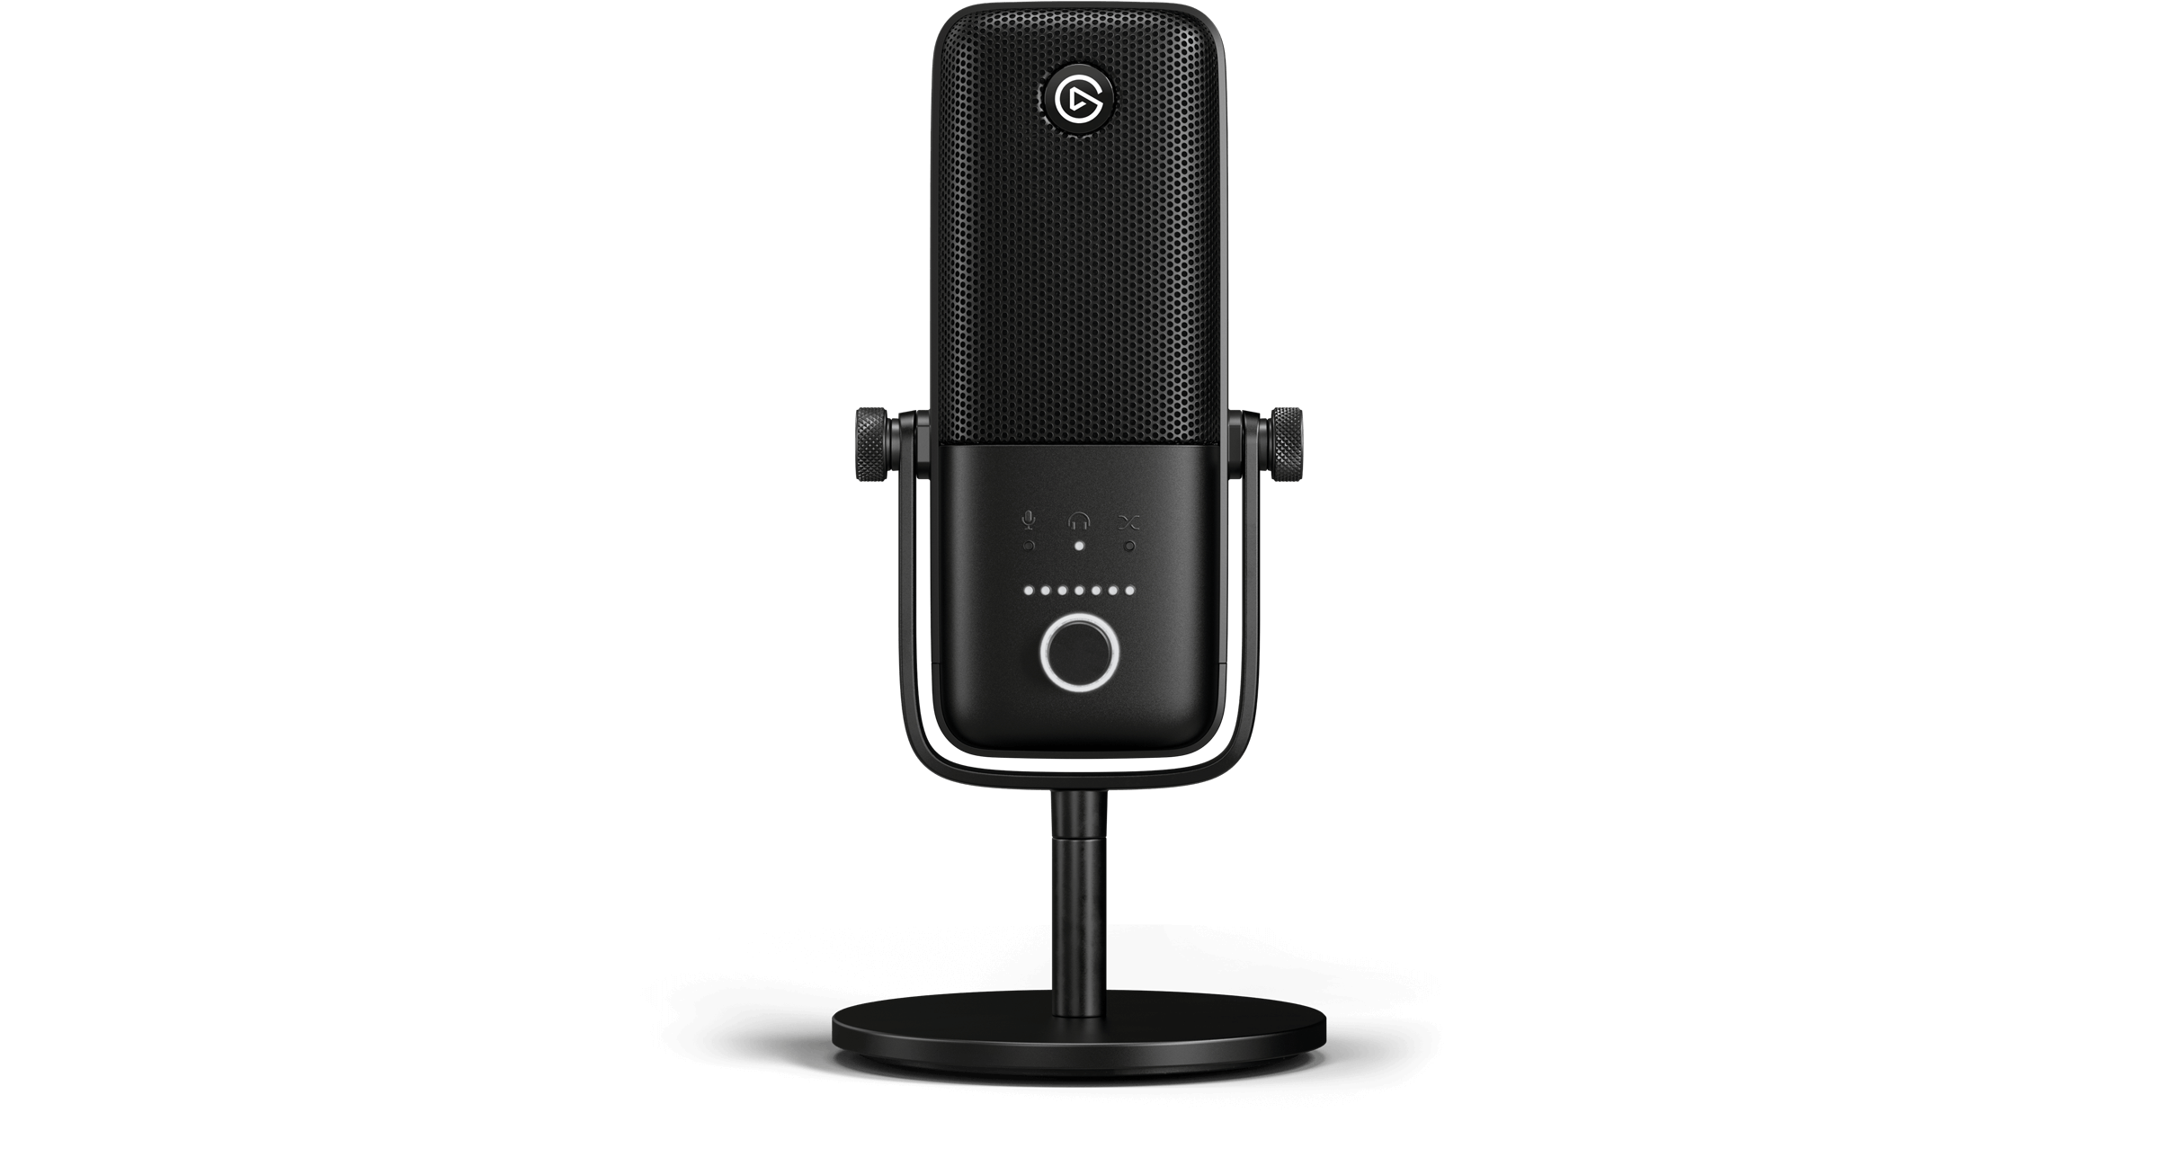
What is an OS?
Protection Boundary
Kernel
File System Networking
Device Drivers Processes
Virtual Memory
Hardware/Software Interface

Slide 15
Protection Boundaries
Multiple privilege levels
Different software can run with different privileges
Processors provide at least two different modes
User space: how “regular” program run
Kernel mode: How the kernel run
The mode determine a number of things
What instructions may be executed
How addresses are translated
What memory locations can be accessed (through translation)

Slide 16
Example Intel
Four modes
Ring 0: most privileged run the kernel here
Ring 1/2: ignored in most environment. Can run less privileged code (e.g. third party device drivers or virtual machine monitors etc.)
Ring 3: where “normal” processes live
Memory is divided in segments
Each segment has a privilege level (0 to 3)
Processor maintain a current privilege level (CPL) generally the CPL of the segment containing the instruction currently executing
Can read/write in segment when CPL >= segment privilege
Cannot directly call code in segment where CPL < segment privilege

Slide 17
Example MIPS
Standard two modes processor
User mode: access CPU registers; flat uniform virtual memory address space
Kernel mode: can access memory mapping hardware and special registers

Slide 18
Changing Protection Level
How do we transfer control between applications and kernel?
When do we transfer control between applications and kernel?

Slide 19
Changing Protection Level: When?
Sleeping beauty approach
Wait for something to happens to wake up the kernel
What might that be?
System calls: an application wants the operating to do something on its behalf (e.g. access some hardware)
Trap: an application does unintentionally something it should not (e.g. divide by zero, read an address it should not etc.)
Interrupts: An asynchronous event (e.g. I/O completion)
Alarm clock approach
Set a timer that generate an interrupt when it finishes

Slide 20
System Call
A system call is a way for programs to interact with the operating system. A computer program makes a system call when it makes a request to the operating system’s kernel.
System call provides the services of the operating system to the user programs via Application Program Interface (API). It provides an interface between a process and operating system to allow user-level processes to request services of the operating system.

Slide 21
Trap
Traps are the general means for invoking the kernel from user code.
We usually think of a trap as an unintended request for kernel service, say that caused by a programming error such as using a bad address or dividing by zero.
Traps can be triggered by an exception or error in a process when executing a function. Conditions like division by zero, a breakpoint, or invalid memory access occur synchronously with the execution of a program. They can result in an exception that changes the operation of the processor. Once the cause of the exception has been handled, the processor returns to its previous activity.

Slide 22
Interrupt
An interrupt is a hardware or software signal that demand attention from the OS.
Unlike a trap, which is handled as part of the program that caused it (though within the operating system in privileged mode), an interrupt is handled independently of any user program.
For example, a trap caused by dividing by zero is considered an action of the currently running program; any response directly affects that program. But the response to an interrupt from a disk controller may or may not have an indirect effect on the currently running program and has no direct effect (other than slowing it down a bit as the processor deals with the interrupt).

